Slide 1
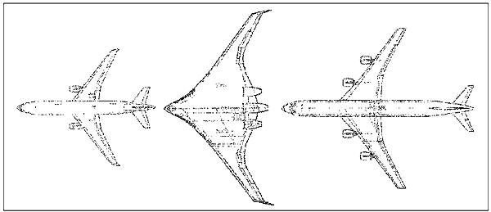
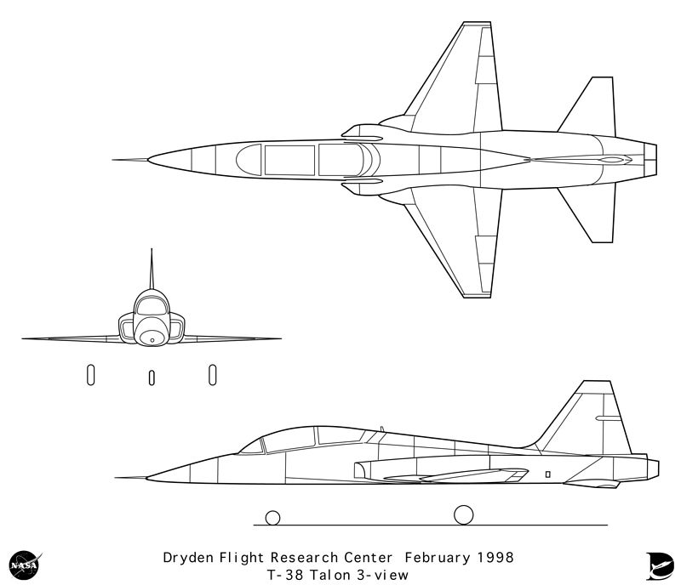
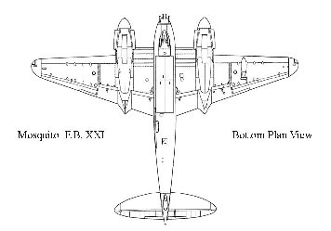
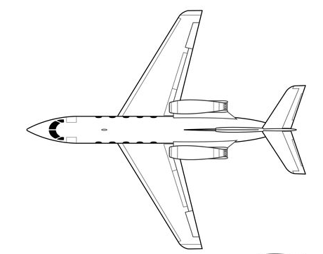

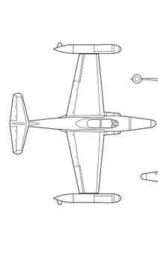
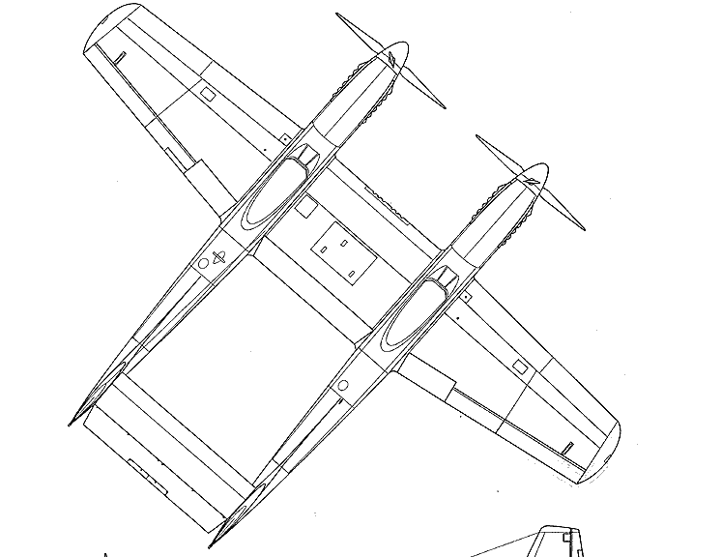
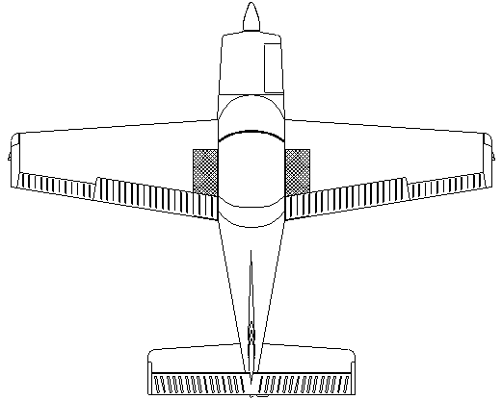
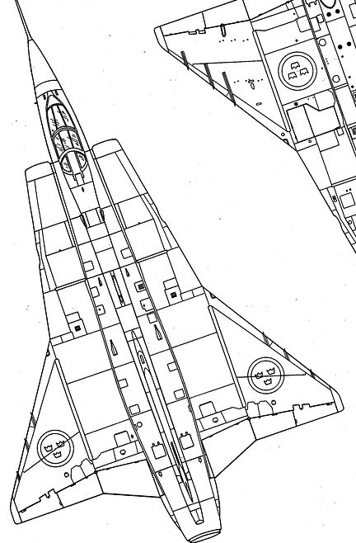
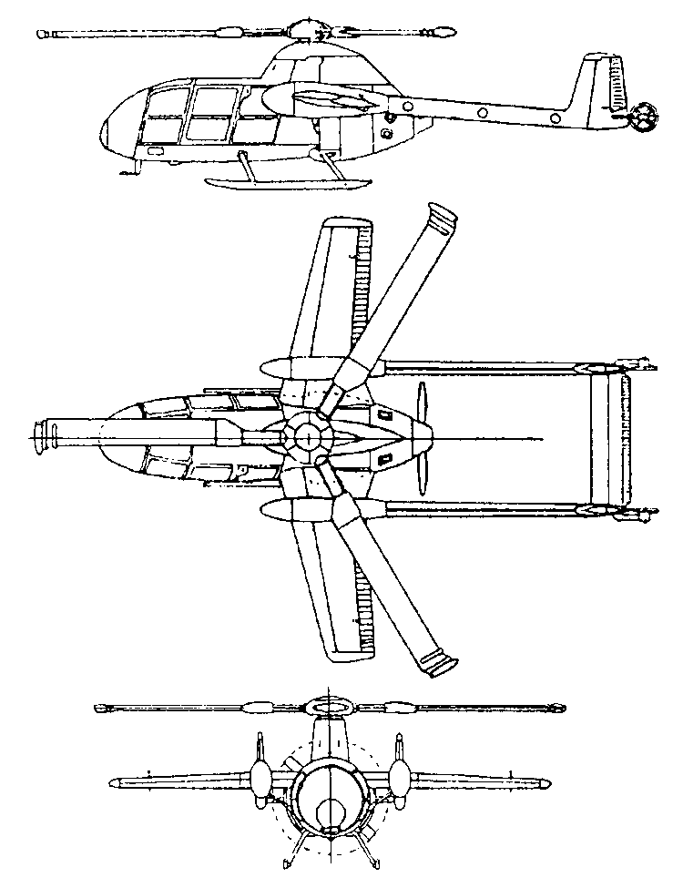
Technical information contained herein may be reproduced only with written permission.
Society of Flight Test Engineers, 44814 N. Elm Avenue Lancaster, CA 93534 USA
345
0
15
330
30
-5
315
45
-10
300
-15
60
Reference Handbook 2007 Edition
285
-20
75
90
255
105
240
120
225
135
210
150
195
180
165

